Slide 1
Data Flow Testing cont…
Dr. Durga Prasad Mohapatra
Professor
CSE Department
NIT Rourkela

Slide 2
Static Analysis is not Enough
All anomalies using static analysis cannot be determined and this is an unsolvable problem.
For example, if the variable is used in an array as the index, we cannot determine its state by static analysis.
Or it may be the case that the index is generated dynamically during execution, therefore we cannot guarantee what the state of the array element is referenced by that index.

Slide 3
Dynamic Data Flow Testing
The test cases are designed in such a way that every definition of data variable to each of its use is traced to each of its definition.
Various strategies are employed for the creation of test cases.
All these strategies are defined below.

Slide 4
Dynamic Data Flow Testing cont…
All-du Paths (ADUP) It states that every definition of every variable to every use of that definition should be exercised under some test. It is the strongest data flow testing strategies.

Slide 5
Dynamic Data Flow Testing cont…
All-uses (AU) This states that for every use of the variable, there is a path from the definition of that variable (nearest to the use in backward direction) to the use.

Slide 6
Dynamic Data Flow Testing cont…
All-p-uses/Some-c-uses (APU + C) This strategy states that for every variable and every definition of that variable, include at least one dc-path from the definition to every predicate use. If there are definitions of the variable with no p-use following it, then add computational use (c-use) test cases as required to cover every definition.
Note: A dc-path (definition-clear path) with respect to a variable v is a path between the definition node & the usage node s.t. that no other node in the path is a defining node of variable v.

Slide 7
Dynamic Data Flow Testing cont…
All-c-uses/Some-p-uses (ACU + P) This strategy states that for every variable and every definition of that variable, include at least one dc-path from the definition to every computational use. If there are definitions of the variable with no c-use following it, then add predicate use (p-use) test cases as required to cover every definition.

Slide 8
Dynamic Data Flow Testing cont…
All-Predicate-uses (APU) It is derived from the APU + C strategy and states that for every variable, there is a path from every definition to every p-use of that definition. If there is a definition with no p-use following it, then it is dropped from contention.

Slide 9
Dynamic Data Flow Testing cont…
All-Computational-Uses (ACU) It is derived from the strategy ACU + P strategy and states that for every variable, there is a path form every definition to every c-use of that definition. If there is a definition with no c-use following it, then it is dropped form contention.

Slide 10
Dynamic Data Flow Testing cont…
All-Definition (AD) It states that every definition of every variable should be covered by at least one use of that variable, be that a computational use or a predicate use.

Slide 11
Example
Consider a program given below. Draw its control flow graph and data flow graph for each variable used in the program, and derive data flow testing paths with all the strategies discussed above.

Slide 12
main()
{
int work;
0. double payment =0;
1. scanf(“%d”, work);
2. if (work > 0) {
3. payment = 40;
4. if (work > 20)
5. {
6. if(work <= 30)
7. payment = payment + (work – 25) * 0.5;
8. else
9. {
10. payment = payment + 50 + (work –30) * 0.1;
11. if (payment >= 3000)
12. payment = payment * 0.9;
13. }
14. }
15. }
16. printf(“Final payment”, payment);

Slide 13
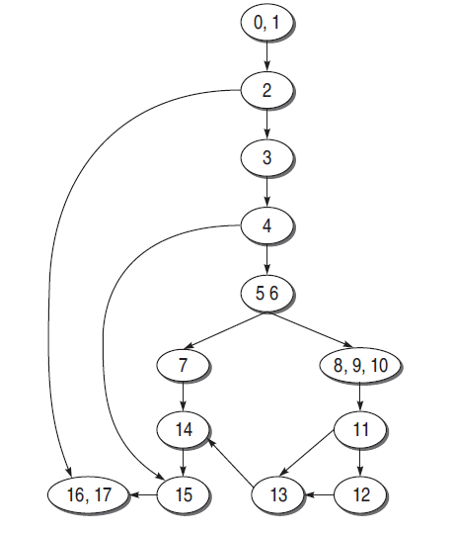
CFG for the Example

Slide 14
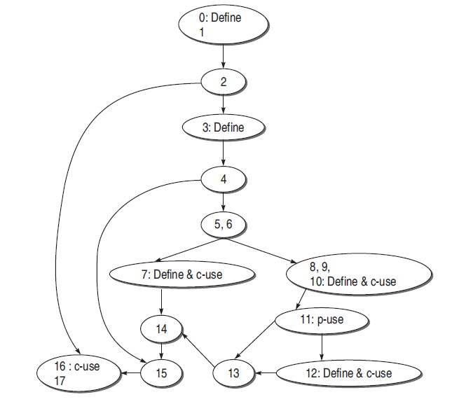
Data flow graph for ‘payment’

Slide 15
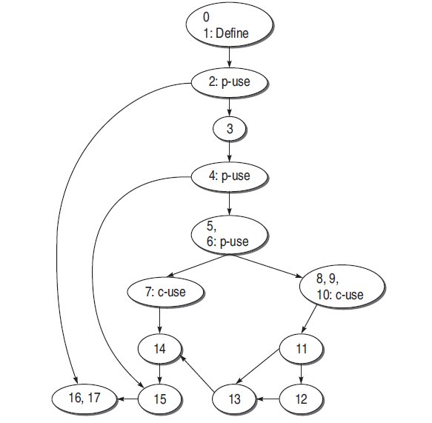
Data flow graph for
variable ‘work’

Slide 16
Prepare a list of all the definition nodes and usage nodes for all the variables in the program.
Variable | Defined At | Used At
Payment | 0,3,7,10,12 | 7,10,11,12,16
Work | 1 | 2,4,6,7,10

Slide 17
Strategy | Payment | Work
All Uses(AU) | 3-4-5-6-7 | 1-2
 | 10-11 | 1-2-3-4
 | 10-11-12 | 1-2-3-4-5-6
 | 12-13-14-15-16 | 1-2-3-4-5-6-7
 | 3-4-5-6-8-9-10 | 1-2-3-4-5-6-8-9-10
All p-uses(APU) | 0-1-2-3-4-5-6-8-9-10-11 | 1-2
 |  | 1-2-3-4
 |  | 1-2-3-4-5-6
All c-uses(ACU) | 0-1-2-16 | 1-2-3-4-5-6-7
 | 3-4-5-6-7 | 1-2-3-4-5-6-8-9-10
 | 3-4-5-6-8-9-10
 | 3-4-15-16
 | 7-14-15-16
 | 10-11-12
 | 10-11-13-14-15-16
 | 12-13-14-15-16

Slide 18
Strategy | Payment | Work
All-p-uses / Some-c-uses (APU + C) | 0-1-2-3-4-5-6-8-9-10-11 | 1-2
 | 10-11-12 | 1-2-3-4
 | 12-13-14-15-16 | 1-2-3-4-5-6
 |  | 1-2-3-4-5-6-8-9-10
All-c-uses / Some-p-uses (ACU + P) | 0-1-2-16 | 1-2-3-4-5-6-7
 | 3-4-5-6-7 | 1-2-3-4-5-6-8-9-10
 | 3-4-5-6-8-9-10 | 1-2-3-4-5-6
 | 3-4-15-16
 | 7-14-15-16
 | 10-11-12
 | 10-11-13-14-15-16
 | 12-13-14-15-16
 | 0-1-2-3-4-5-6-8-9-10-11

Slide 19
Strategy | Payment | Work
All-du-paths (ADUP) | 0-1-2-3-4-5-6-8-9-10-11 | 1-2
 | 0-1-2-16 | 1-2-3-4
 | 3-4-5-6-7 | 1-2-3-4-5-6
 | 3-4-5-6-8-9-10 | 1-2-3-4-5-6-7
 | 3-4-15-16 | 1-2-3-4-5-6-8-9-10
 | 7-14-15-16
 | 10-11-12
 | 10-11-13-14-15-16
 | 12-13-14-15-16
All Definitions (AD) | 0-1-2-16 | 1-2
 | 3-4-5-6-7
 | 7-14-15-16
 | 10-11
 | 12-13-14-15-16

Slide 20
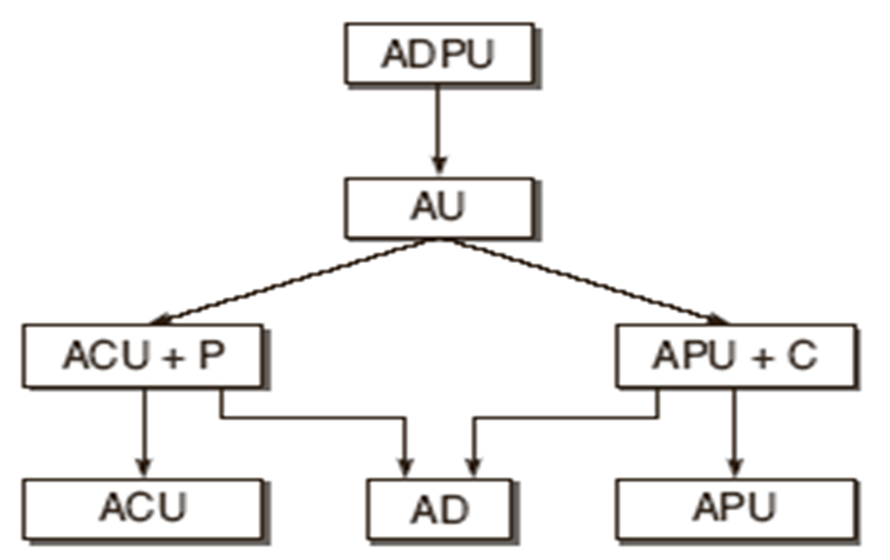
Ordering of data flow testing strategies
While selecting a test case, we need to analyse the relative strengths of various data flow testing strategies.

Slide 21
Ordering of data flow testing strategies cont…
The previous Figure depicts the relative strength of the data flow strategies.
In this figure, the relative strength of testing strategies reduces along the direction of the arrow.
It means that all-du-paths (ADUP) is the strongest criterion for selecting the test cases.

Slide 22
Loop testing
Loop testing can be viewed as an extension to branch coverage.
Loops are important in the software from the testing view point. If loops are not tested properly, bugs can go undetected.
Loop testing can be done effectively while performing development testing (unit testing by the developer) on a module.
Sufficient test cases should be designed to test every loop thoroughly.
There are four different kinds of loops. How each kind of loop is tested, is discussed below.

Slide 23
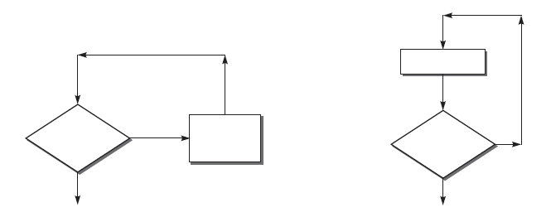
Simple loops
Simple loops mean, we have a single loop in the flow, as shown below.

Slide 24
Testing Simple Loops
Check whether you can bypass the loop or not. If the test case for bypassing the loop is executed and, still you enter inside the loop, it means there is a bug.
Check whether the loop control variable is negative.
Write one test case that executes the statements inside the loop.

Slide 25
Testing Simple Loops cont …
Write test cases for a typical number of iterations through the loop.
Write test cases for checking the boundary values of the maximum and minimum number of iterations defined (say max and min) in the loop. It means we should test for min, min+1, min−1, max−1, max, and max+1 number of iterations through the loop.

Slide 26
Nested loops
When two or more loops are embedded, it is called a nested loop, as shown in next slide. If we have nested loops in the program, it becomes difficult to test.

Slide 27
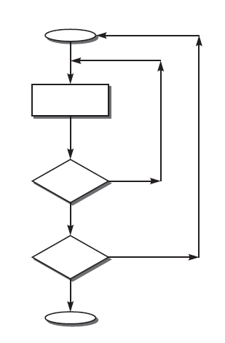
Nested loops

Slide 28
Testing Nested Loops
If we adopt the approach of simple tests to test the nested loops, then the number of possible test cases grows geometrically.
Thus, the strategy is to start with the innermost loops while holding outer loops to their minimum values. Continue this outward in this manner until all loops have been covered

Slide 29
Concatenated loops
The loops in a program may be concatenated (shown in next slide).
Two loops are concatenated if it is possible to reach one, after exiting the other, while still on a path from entry to exit.
If the two loops are not on the same path, then they are not concatenated.
The two loops on the same path may or may not be independent.
If the loop control variable for one loop is used for another loop, then they are concatenated, but nested loops should be treated like nested only.

Slide 30
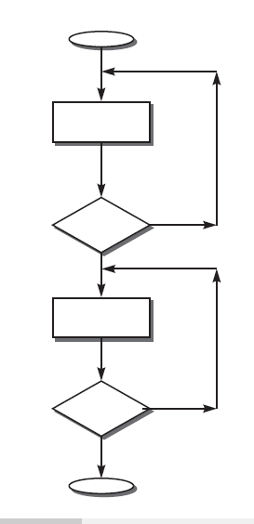
Concatenated loops

Slide 31
Testing Concatenated Loops
The concatenated loop may be treated as a sequence of two or more numbers of simple loops.
So, the strategy for testing of simple loops may be extended to testing of concatenated loops.

Slide 32
Unstructured loops
This type of loops is really impractical to test.
They must be redesigned or at least converted into simple or concatenated loops.

Slide 33
Summary
Explained dynamic data flow testing strategies with an example.
Presented the ordering of different data flow testing strategies.
Discussed different loop testing strategies.

Slide 34
References
Naresh Chauhan, Software Testing: Principles and Practices, (Chapter – 5), Second Edition, Oxford University Press, 2016.

Slide 35
Thank you

